Slide 1
Identifying Question Pairs with the Same Intent in the Quora Questions Pairs Corpus
Sarmad Tanwir
Springboard Capstone Project 2
August 24, 2017

Slide 2
Outline
Objective and Background
Getting Data
Data Exploration
Development of Predictive Models
Initial Pitfalls
Trained Models
Conclusions
Recommendations

Slide 3
Objective and Background
The Small and Medium Enterprises (SMEs) occupy a significant share of the economy of any country
It’s in the interest of any nation to appropriately fund these businesses
Financial models of big corporations not readily applicable to the SMEs
Wharton School of Business has maintained a database of company financials for many decades
Earlier studies exist that have attempted to predict the credit worthiness of SMEs from this data [Altman 2007]
Can we train our own model to predict the bankruptcy of US SMEs on similar data from a different decade?

Slide 4
Getting Data
Quora is a website where people ask questions
It is useful to know duplication in questions to minimize the seeker and writer effort
Quora provided dataset is available at Kaggle
https://www.kaggle.com/c/quora-question-pairs
Access to the data is public
Available dataset is clean and has 6 variables
Pair ID, Q1 ID, Q2 ID, Q1 Text, Q2 Text, Is_Duplicate

Slide 5
Getting Data (Contd.)
Description of Variables
 | Name | Description
1 | Pair ID | Unique identifier for question pair
2 | Q1 ID | Unique question ID
3 | Q2 ID | Unique question ID
4 | Question 1 | Text of question 1
5 | Question 2 | Text of question 2
6 | Is_duplicate | Class label indicating whether the pair consists of duplicate questions

Slide 6
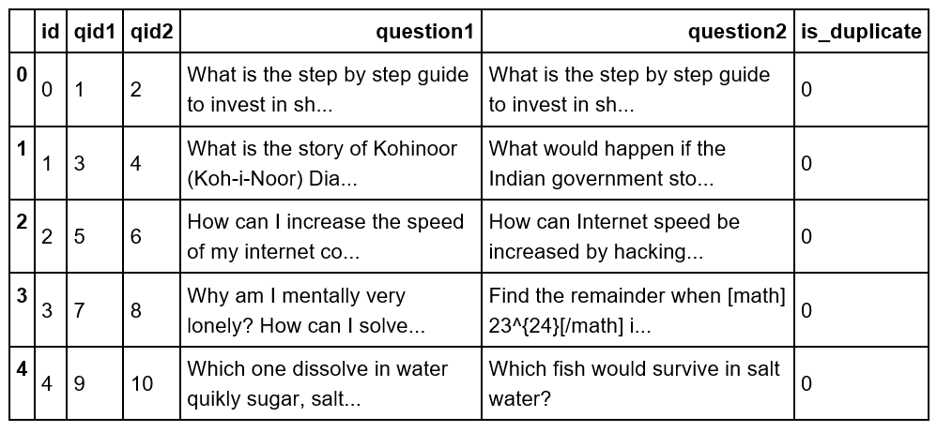
Data Exploration – A Peek into Dataset
Top 5 rows (head) of dataset looks as follows:-

Slide 7
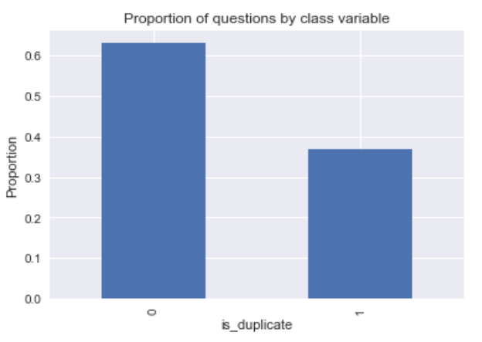
Data Exploration – Proportion of Duplicates

Slide 8
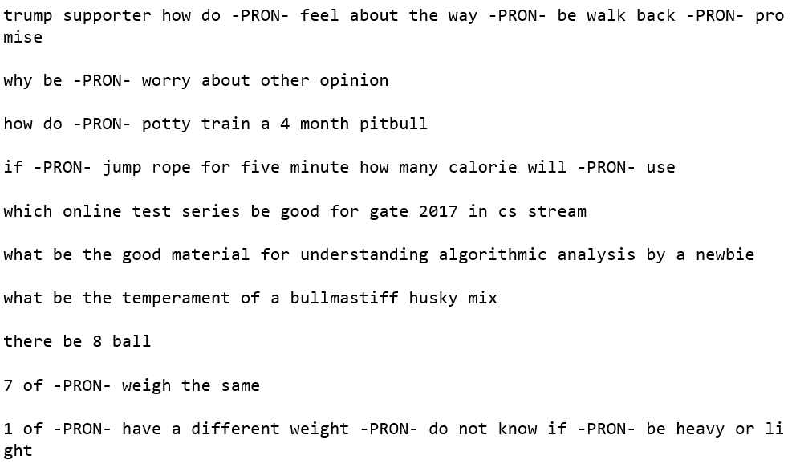
Preprocessing – Lemmatization and Punctuation Removal
We first convert all text to utf-8 for ease in future processing
We lemmatize using spaCy and remove punctuations
A sample of lemmatized question is provided
All pronouns change to –PRON- token
All verbs changed to their basic form e.g. is/are changed to be

Slide 9
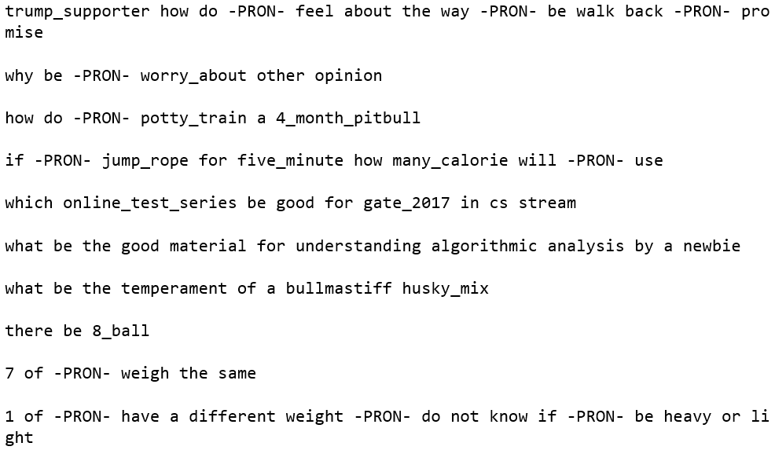
Preprocessing – Learning N-grams
We incrementally learn bigrams and trigrams
Pairs and triplets of words that occur together in corpus
E.g. we see bigrams such as trump_supporter and potty_train and a trigram online_test_series

Slide 10
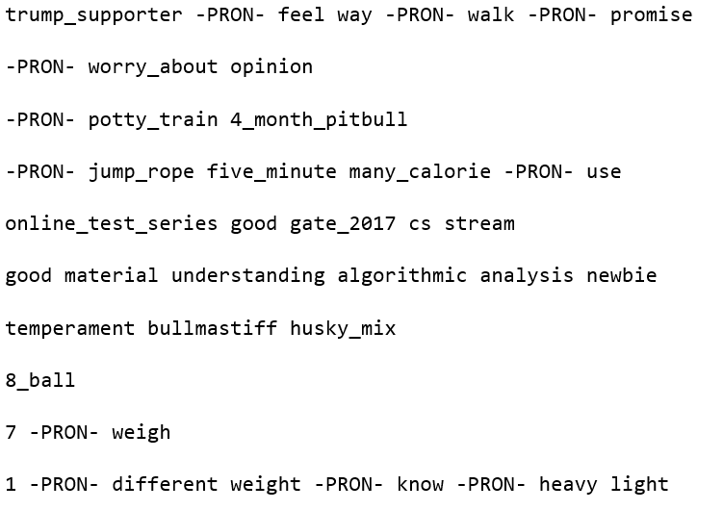
Preprocessing – Stopword Removal
We remove stop words such as ‘the’, ‘or’ etc.

Slide 11
Feature Generation – Vectorizations
We build a bag of words representation of the trigram corpus and save it to disk
We then build a TfIdf representation from the bag of words representation

Slide 12
Feature Generation – Embeddings
We employ topic learning using Latent Dirichlet Allocation (LDA) and Latent Semantic Indexing (LSI) using genism
For exploratory analysis, we learn 50 topics
For final analysis, we learn 300 topics
Then, we apply learned models to each question and save resulting vector embeddings in a .csv file
In addition to LSI, we also use the 400 dimensional Doc2Vec embedding provided by gensim

Slide 13
Explored Models
We try out a number of models to better classify the data
Initial exploration
Random Forest
Support Vector Machine
Final Analysis
SGD
Perceptron
Passive Aggressive
Neural Networks

Slide 14
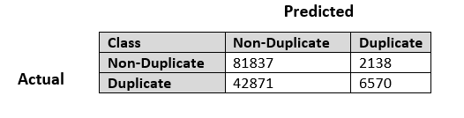
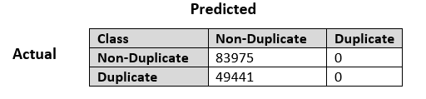
Initial Exploration
To begin with we tried learning a Random Forest classifier over the 50-topic LDA features (1min 5sec)
Accuracy: 66.26%
Confusion Matirx
We also attempted using SVM (2d 2hr 42 min, out of core)
Accuracy: 62.94%
Confusion Matrix

Slide 15
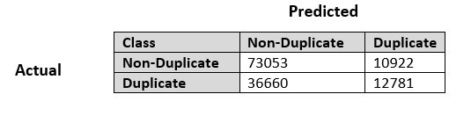
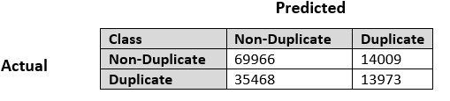
Out-of-Core Learning
Were unable to train with 300 LSI features with available RAM
Switched to out-of-core classifiers
Passive Aggressive
Accuracy: 64.3%
Confusion Matirx
Perceptron
Accuracy: 62.9%
Confusion Matrix

Slide 16
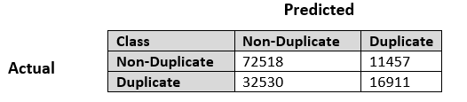
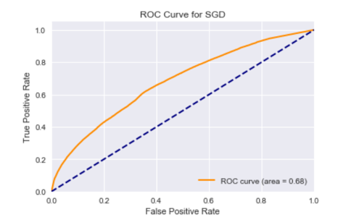
Out-of-Core Learning (contd.)
SGD (with hyperparameter tuning: loss = ‘modified_huber’, class_weight = ‘balanced’
Accuracy: 67%
Confusion Matirx
ROC Curve
AUC = 0.68

Slide 17
Using Deep Learning
Decided to use neural networks for improving classifier performance
Configuration
Input Layer: 600
Hidden Layer1: 600 neurons, initializer = ‘uniform’, activation =‘relu’
Hidden Layer1: 600 neurons, initializer = ‘uniform’, activation =‘relu’
Output Layer: 1 neuron, initializer = ‘uniform’, activation = ‘sigmoid’
Loss Function: ‘binary crossentropy’
Optimizer: ‘adam’
Epochs: 20
Batch size:10000

Slide 18
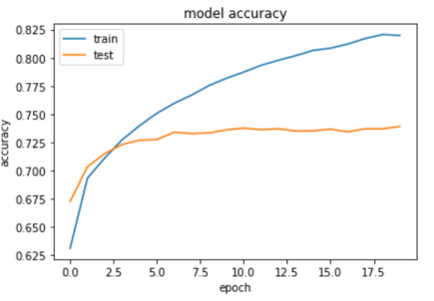
NN Performance with 300 LSI Topics
Average 10-fold cross-validated accuracy: 74.03%
Accuracy history

Slide 19
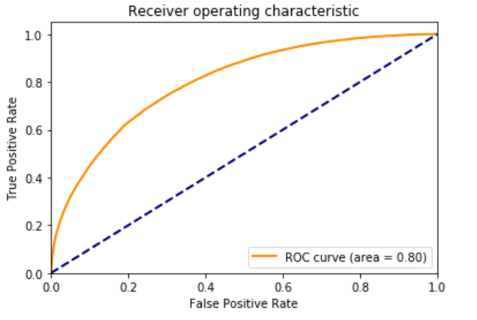
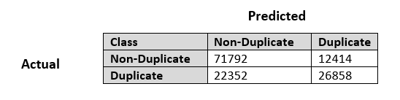
NN Performance with 300 LSI Topics
ROC Curve for Test Set
Confusion Matrix

Slide 20
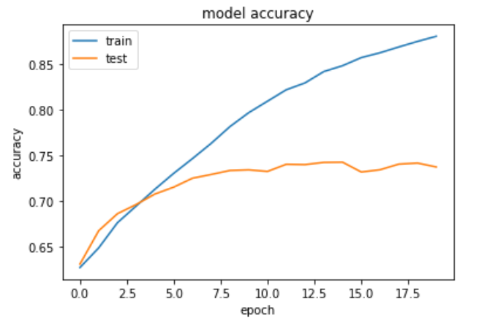
NN Performance with 300 LDA Topics
Average 10-fold cross-validated accuracy: 74.58%
Accuracy history

Slide 21
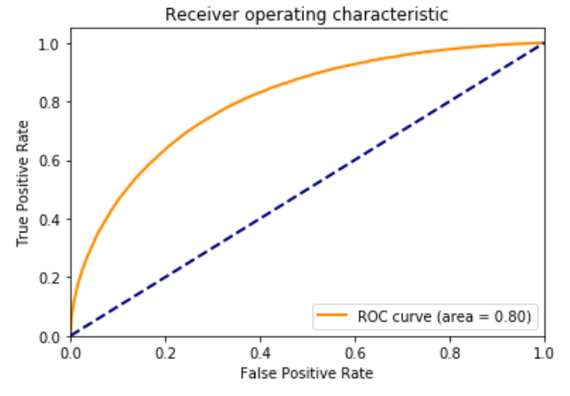
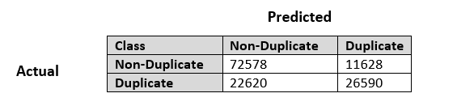
NN Performance with 300 LDA Topics
ROC Curve for Test Set
Confusion Matrix

Slide 22
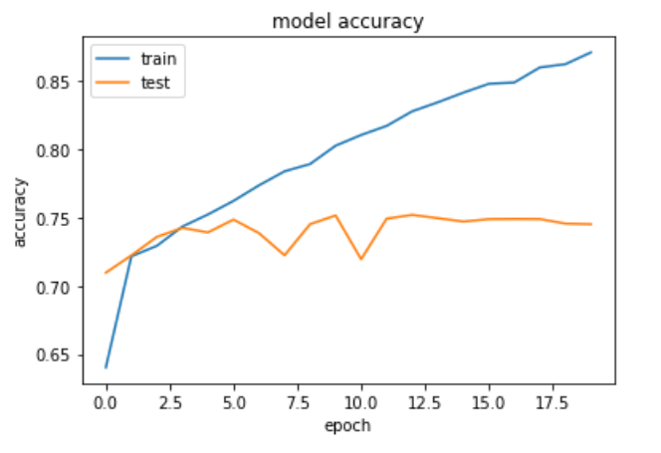
NN Performance w/ 400 Doc2Vec Dim
Average 10-fold cross-validated accuracy: 75.07%
Accuracy history

Slide 23
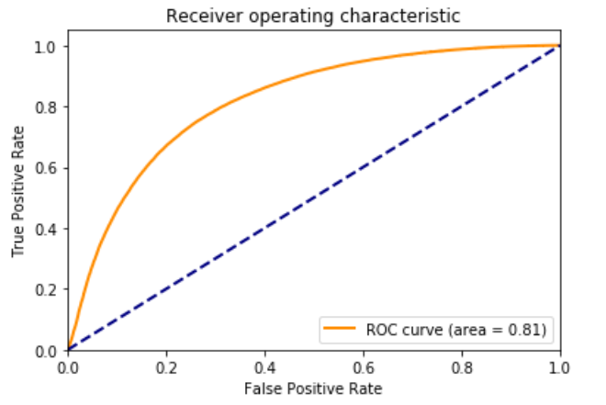
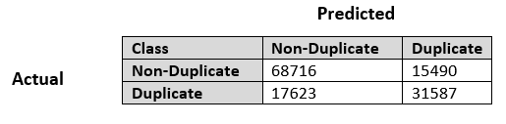
NN Performance w/ 400 Doc2Vec Dim
ROC Curve for Test Set
Confusion Matrix

Slide 24
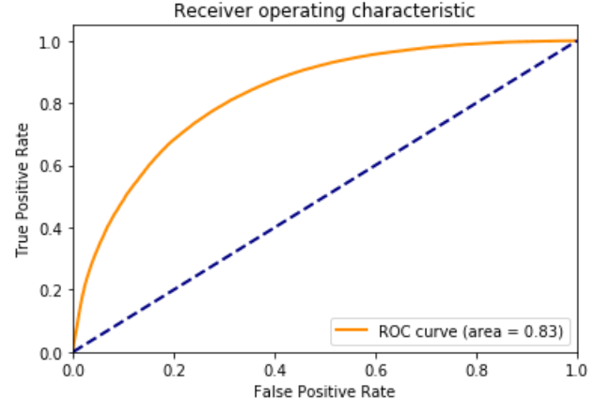
D2V NN Performance with Dropout
Accuracy: 75.34%
ROC Curve for Test Set

Slide 25
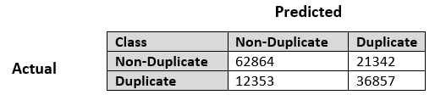
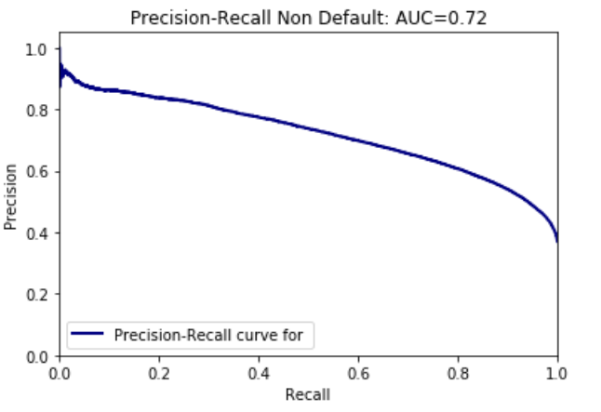
D2V NN Performance with Dropout
Confusion Matrix
Precision Recall Curve

Slide 26
Summary
Classifier | Features | Accuracy | Precision | Recall | ROC AUC
Random Forest | 50-topic LDA | 0.6626 | 0.7545 | 0.1329 | NM
SVM | 50-topic LDA | 0.6294 | 0.0000 | 0.0000 | NM
SGD | 50-topic LDA | 0.6607 | 0.6152 | 0.2255 | 0.68
Pass. Aggr. | 300-topic LSI | 0.6434 | 0.5392 | 0.2585 | NM
Perceptron | 300-topic LSI | 0.6292 | 0.4994 | 0.2826 | NM
SGD | 300-topic LSI | 0.6703 | 0.5961 | 0.3420 | 0.68
NN | 300-topic LSI | 0.7394 | 0.6839 | 0.5458 | 0.80
NN w/ dropout | 300-topic LSI | 0.7326 | 0.6526 | 0.5881 | 0.80
NN | 300-topic LDA | 0.7433 | 0.6957 | 0.5403 | 0.80
NN w/ dropout | 300-topic LDA | 0.7430 | 0.6874 | 0.5560 | 0.81
NN | 400-dim D2V | 0.7518 | 0.6710 | 0.6419 | 0.81
NN w/ dropout | 400-dim D2V | 0.7534 | 0.6504 | 0.7164 | 0.83

Slide 27
Conclusions
Experimented with 3 types of NLP features namely LSI, LDA and Doc2Vec
We find that LDA is marginally better than LSI
Doc2Vec is better that LDA/LSI if it is trained for more epochs
Results with 10, 20 epochs are not better than LSI
Results with 50 epochs are better than LSI
Experimented with Random Forest, SGD, Passive Aggressive and Perceptron classifiers
SGD performs best out of these
Neural net based model is better than other explored classifiers
Needs GPU for faster execution
A 20% dropout works well for reducing overfitting a bit
We see a consistent improvement in the recall of the duplicate class as we continue to improve the model

Slide 28
Recommendations
The following measures may further improve classifier prediction performance
Increasing the number of neuron and layer and using more aggressive dropout
Using L1/L2 regularization
Training with LSTM instead of regular neural networks
Building an ensemble of trained classifier
Including statistical features

Slide 29
Thank you

